Slide 1
Sign Language Recognition from Hand Gesture using Neural Network & Machine Learning
Group-11

Slide 2
Outline
Our presentation will go according to this sequence
Introduction & Motivation
Sign Language
What is Sign Language
Why we are solving this problem
How we are going to solve the problem
Literature Review
Existing Solution
Renowned Paper
Proposed Solution
Model
Dataset
Result & Compare
Future Scope
Conclusion

Slide 3



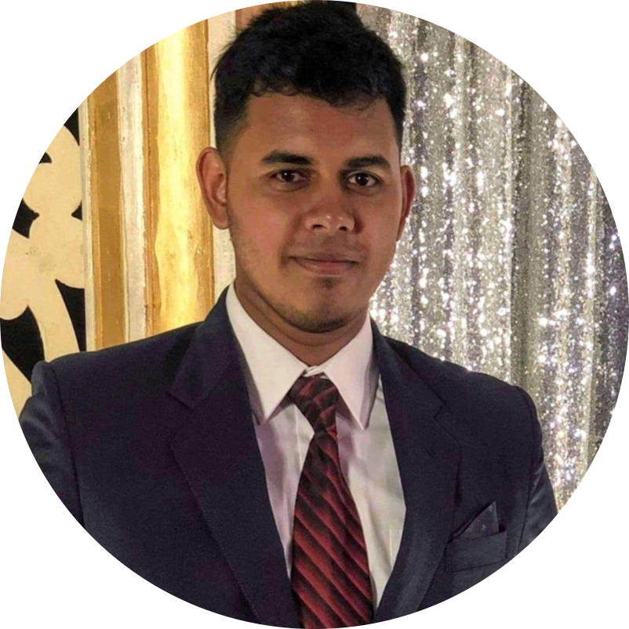
Groupmate
Rezowan Khan
Malisha Rahman
Farida Yeasmin
Atif Karim
Training and Testing
BDSL with IV3
ASL with IV3
Research
Collecting Dataset
BdSL
BSL
ASL-1 & ASL-2
Algorithm design, Training and Testing
Inception V3
VGG 16
Research
Designing the algorithm
BDSL with NN
ASL with NN
Research

Slide 4
Introduction
&
Motivation

Slide 5
Introduction
Sign Language is a way to communicate by showing gesture

Slide 6
“According to the World Federation of the Deaf, there are more than 70 million deaf people worldwide.”
—United Nation

Slide 7
Motivation
Deaf people are a big part of our society. They deserve to be treated as equal.

Slide 8
“Only very few non-deaf people know sign language. This not only creates a communication gap but also make an inequity. . ”
—Wikipedia

Slide 9
Sign Language

Slide 10
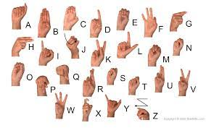
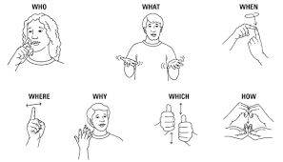
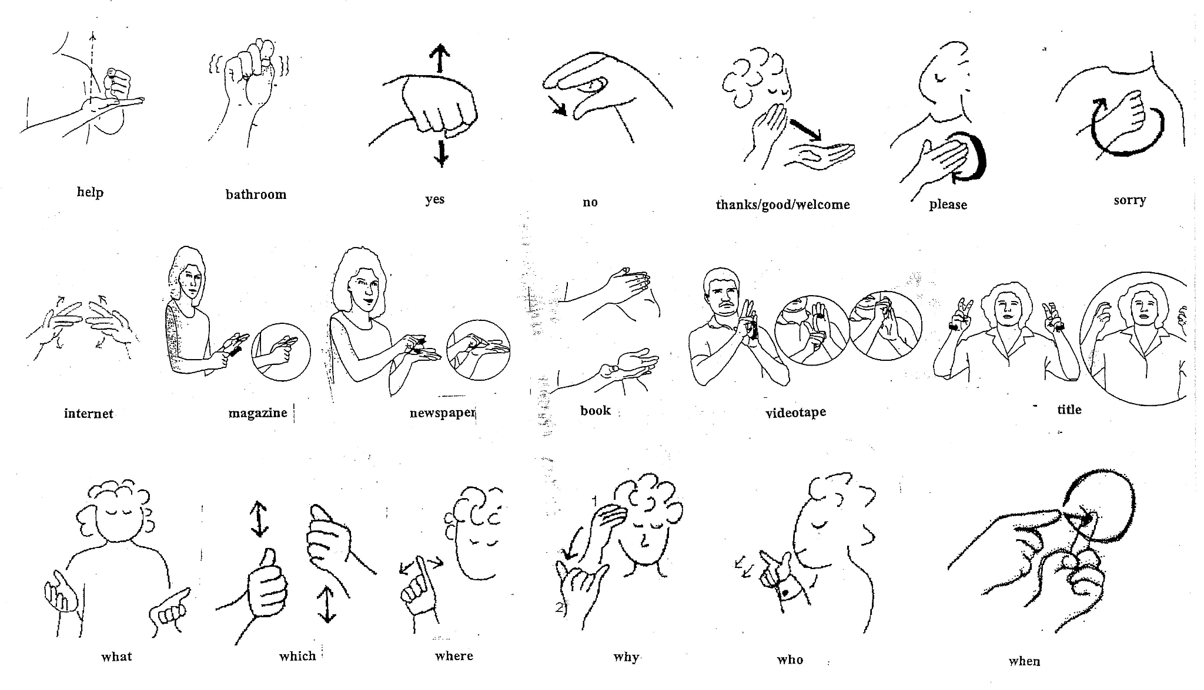
What is Sign Language
Sign languages are languages that use the visual-manual modality to convey meaning.
Notes:
Sign language is manual communication commonly used by people who are deaf. Sign language is not universal; people who are deaf from different countries speak different sign languages. The gestures or symbols in sign language are organized in a linguistic way. Each individual gesture is called a sign.

Slide 11
Why are we solving it
Make a Bridge
Social Impact
It’s Easy
To make a bridge in between regular people with deaf and mute one.
To make the deaf and mute people a part of our society.
To make a simple effective method instead of learning sign language.
Notes:
Sign language is manual communication commonly used by people who are deaf. Sign language is not universal; people who are deaf from different countries speak different sign languages. The gestures or symbols in sign language are organized in a linguistic way. Each individual gesture is called a sign.

Slide 12
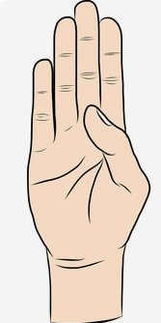
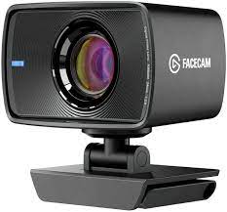
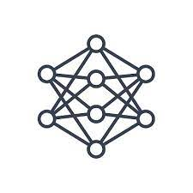
How the solution works
Hand Gesture
Data Reading Device
Detecting the sing using NN
Showing text format of the sign.
B
Notes:
Sign language is manual communication commonly used by people who are deaf. Sign language is not universal; people who are deaf from different countries speak different sign languages. The gestures or symbols in sign language are organized in a linguistic way. Each individual gesture is called a sign.

Slide 13
Hand Gesture
Data Reading Device
Detecting the sing using NN
Showing text format of the sign.
B
Notes:
Sign language is manual communication commonly used by people who are deaf. Sign language is not universal; people who are deaf from different countries speak different sign languages. The gestures or symbols in sign language are organized in a linguistic way. Each individual gesture is called a sign.

Slide 14
Literature Review

Slide 15
Renowned Studies
99.28% accuracy.
Bangla Sign alphabet recognition with zero-shot and transfer learning
95.21% accuracy.
Real-Time Sign Language Gesture (Word) Recognition from Video Sequences Using CNN and RNN.
99.4% accuracy.
Design of Sign Language Recognition Using E-CNN
Repeat
98% accuracy.
We intend to keep doing this process till we can get a big pool of values through which we can find the best and most efficient to use.
Deepsign: Sign Language Detection and Recognition Using Deep Learning

Slide 16
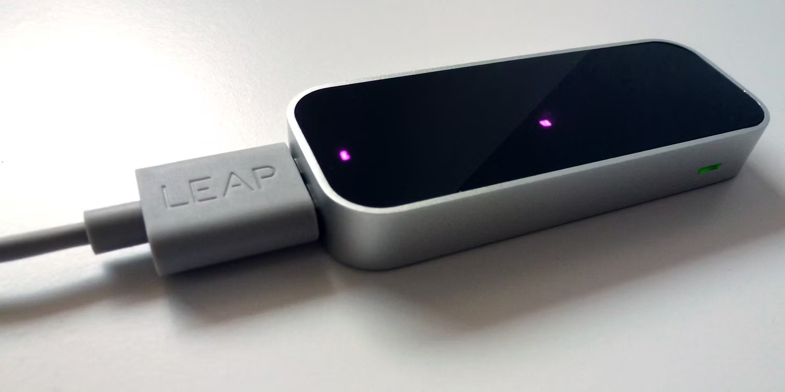
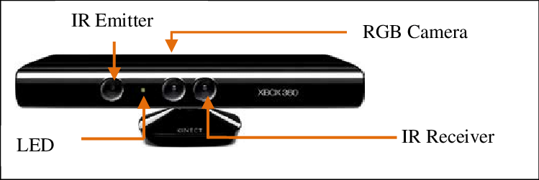
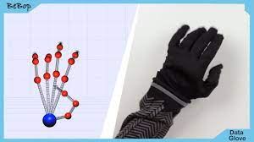
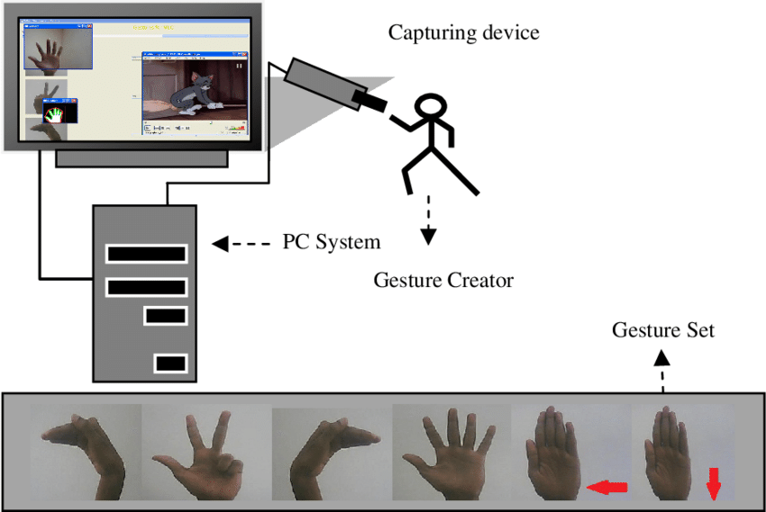
Existing Data Reading Technique
American Sign Language (87 thousand image dataset):
Leap Motion Controller
Kinect Sensor
Data Gloves
Vision Based

Slide 17
Existing Data Reading Technique
American Sign Language (87 thousand image dataset):
Leap Motion Controller
Kinect Sensor
Data Gloves
Vision Based

Slide 18
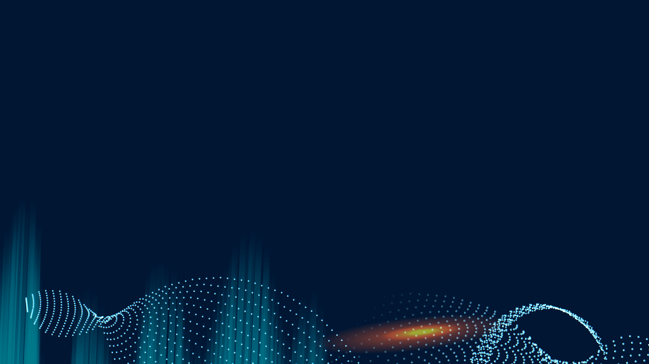
Why our solution is better
Will use large dataset
Why our solution is better
Testing same dataset with various algorithm
Will check accuracy with many algorithm
Testing same algorithm with various dataset
Model Combining

Slide 19
Proposed Solution

Slide 20
Model-01
Inception V3

Slide 21
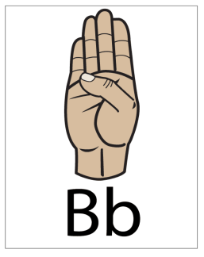
Inception V3
Convolution
Convolution
Convolution
Output
FULLY CONNECTED
Bb
Pooling
Pooling

Slide 22
Model-02
VGG-16

Slide 23
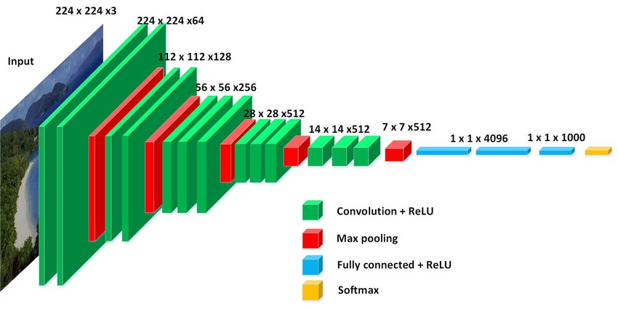
VGG-16

Slide 24
Dataset
We have used 3 dataset to train our model and to test the accuracy.

Slide 25
Datasets
Bangla Sign Language
Bangla Sign Language
American Sign Language
American Sign Language
BdSL
BSL
ASL-1
ASL-2
34,151 Images
21,338 for training
12,813 for testing
Source: BdSL using Zero Shot Learning (Paper)
12,581 Images
8,068 for training
4.513 for testing
Source: Kaggle (Open Source)
6,500 Images
5,200 for training
1,300 for testing
Source: Kaggle (Open Source)
87,000 Images
69,600 for training
17,400 for testing
Source: Kaggle (Open Source)

Slide 26
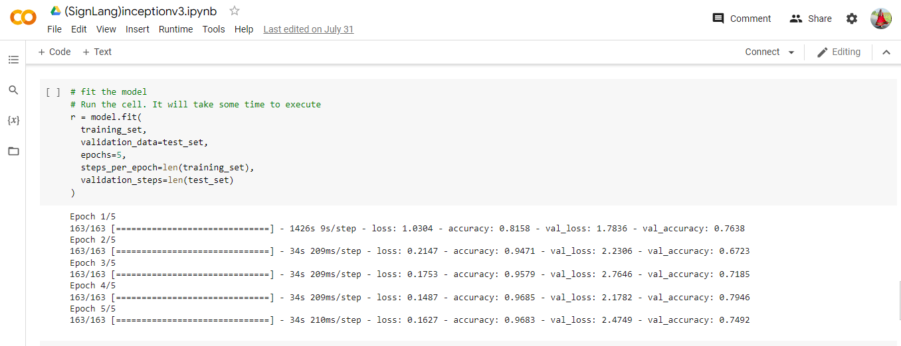
Inception V3
American Sign Language: (6 thousand images dataset)
American Sign Language (87 thousand image dataset):

Slide 27
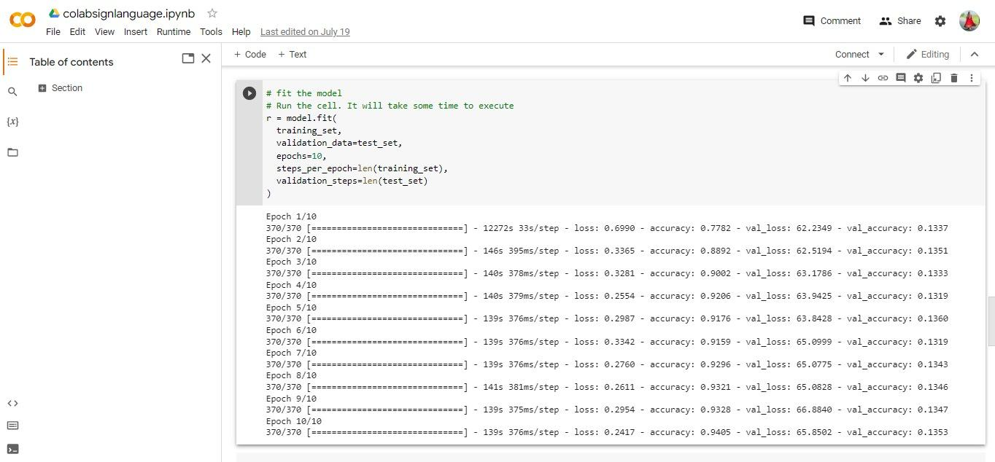
American Sign Language: (87 thousand images dataset)

Slide 28
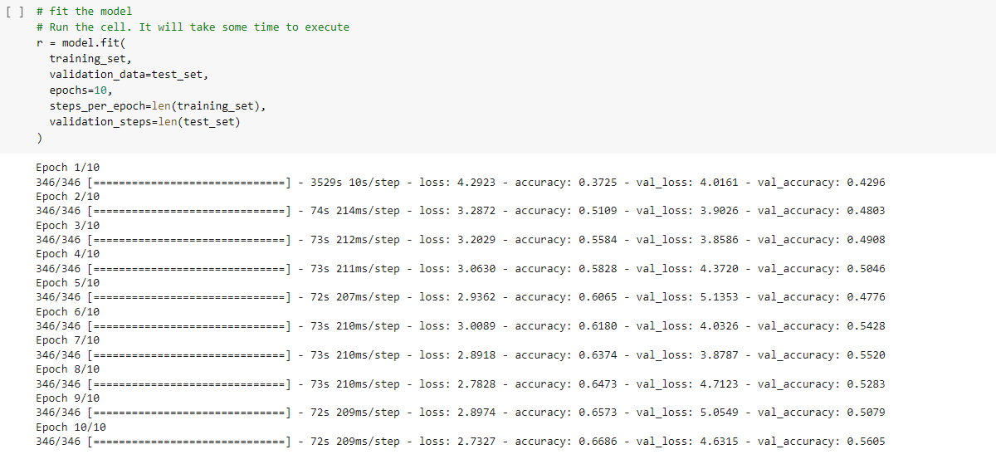
Bangla Sign Language (12 thousand images dataset- number image)
American Sign Language (87 thousand image dataset):

Slide 29
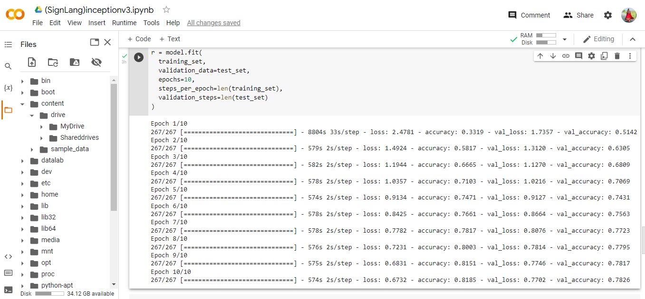
Bangla Sign Language (Zero-Shot Learning): (35 thousand images)

Slide 30
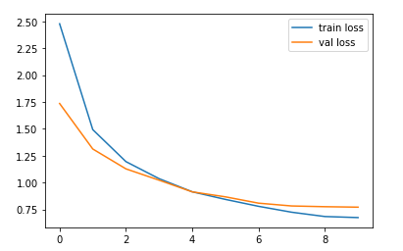
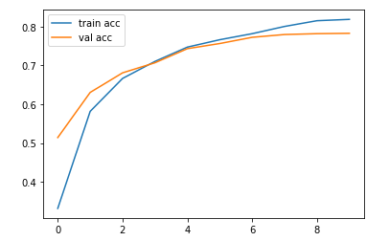
plot the loss
For BDSL Dataset
Plotting the Loss
Plotting the Accuracy

Slide 31
Inception V3
American Sign Language(Paper)
Bangla Sign Language(Paper)
Bangla Sign Language
American Sign Language
BdSL
BSL
ASL-1
ASL-2
79% Accuracy
56% Accuracy
80% Accuracy
15% Accuracy

Slide 32
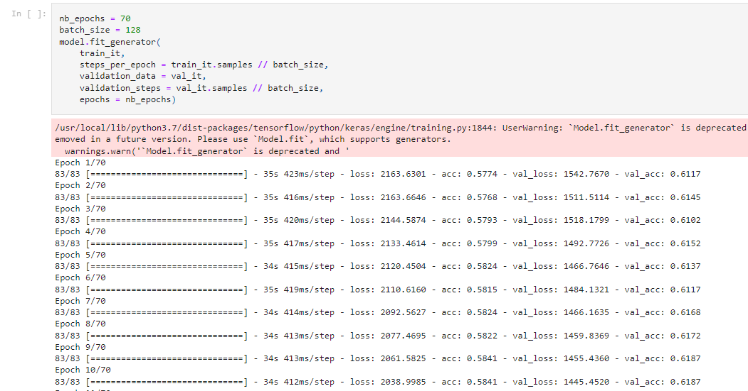
Dataset 1 of BdSL

Slide 33
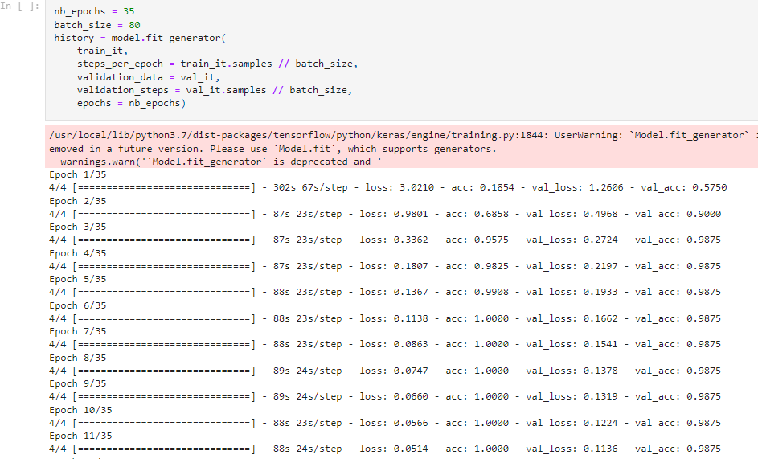
Dataset 2 of BdSL

Slide 34
Bangla Sign Language (Zero-Shot Learning): (35 thousand images)

Slide 35
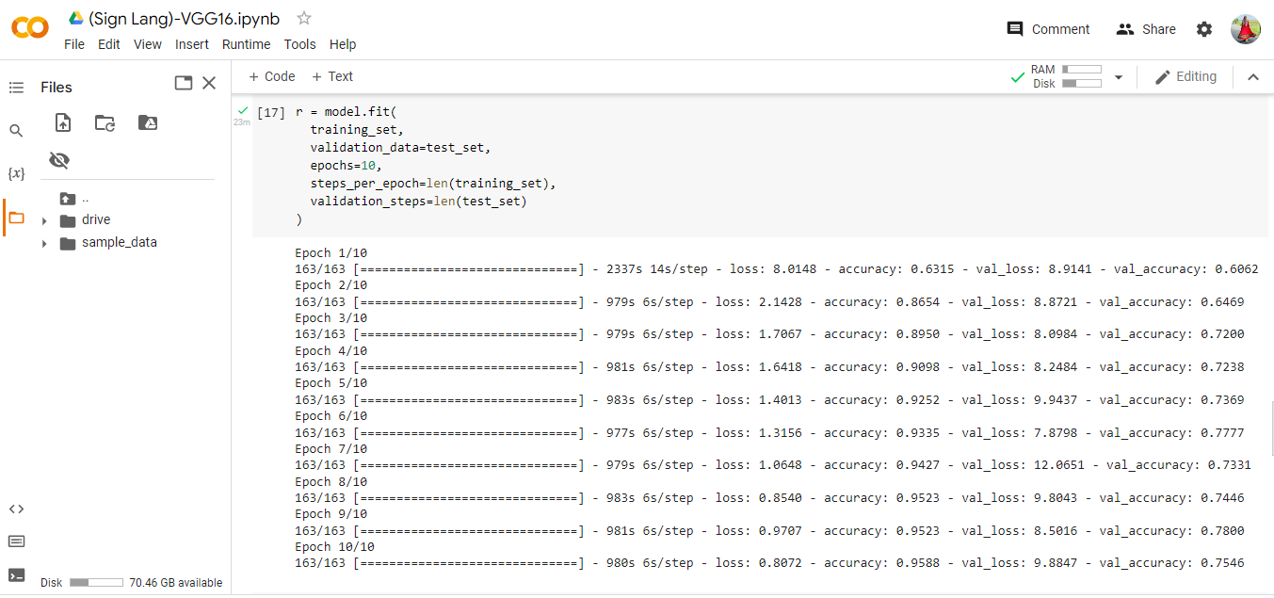
VGG16
American Sign Language datasets

Slide 36
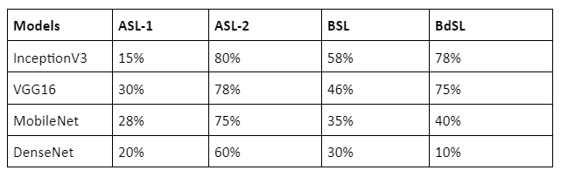

Slide 37
Success
More accuracy.
Successfully implemented multiple algorithms.
Failure
Couldn’t get the highest Accuracy yet.
Need more model & algorithm to check the accuracy level.

Slide 38
Prototype

Slide 39
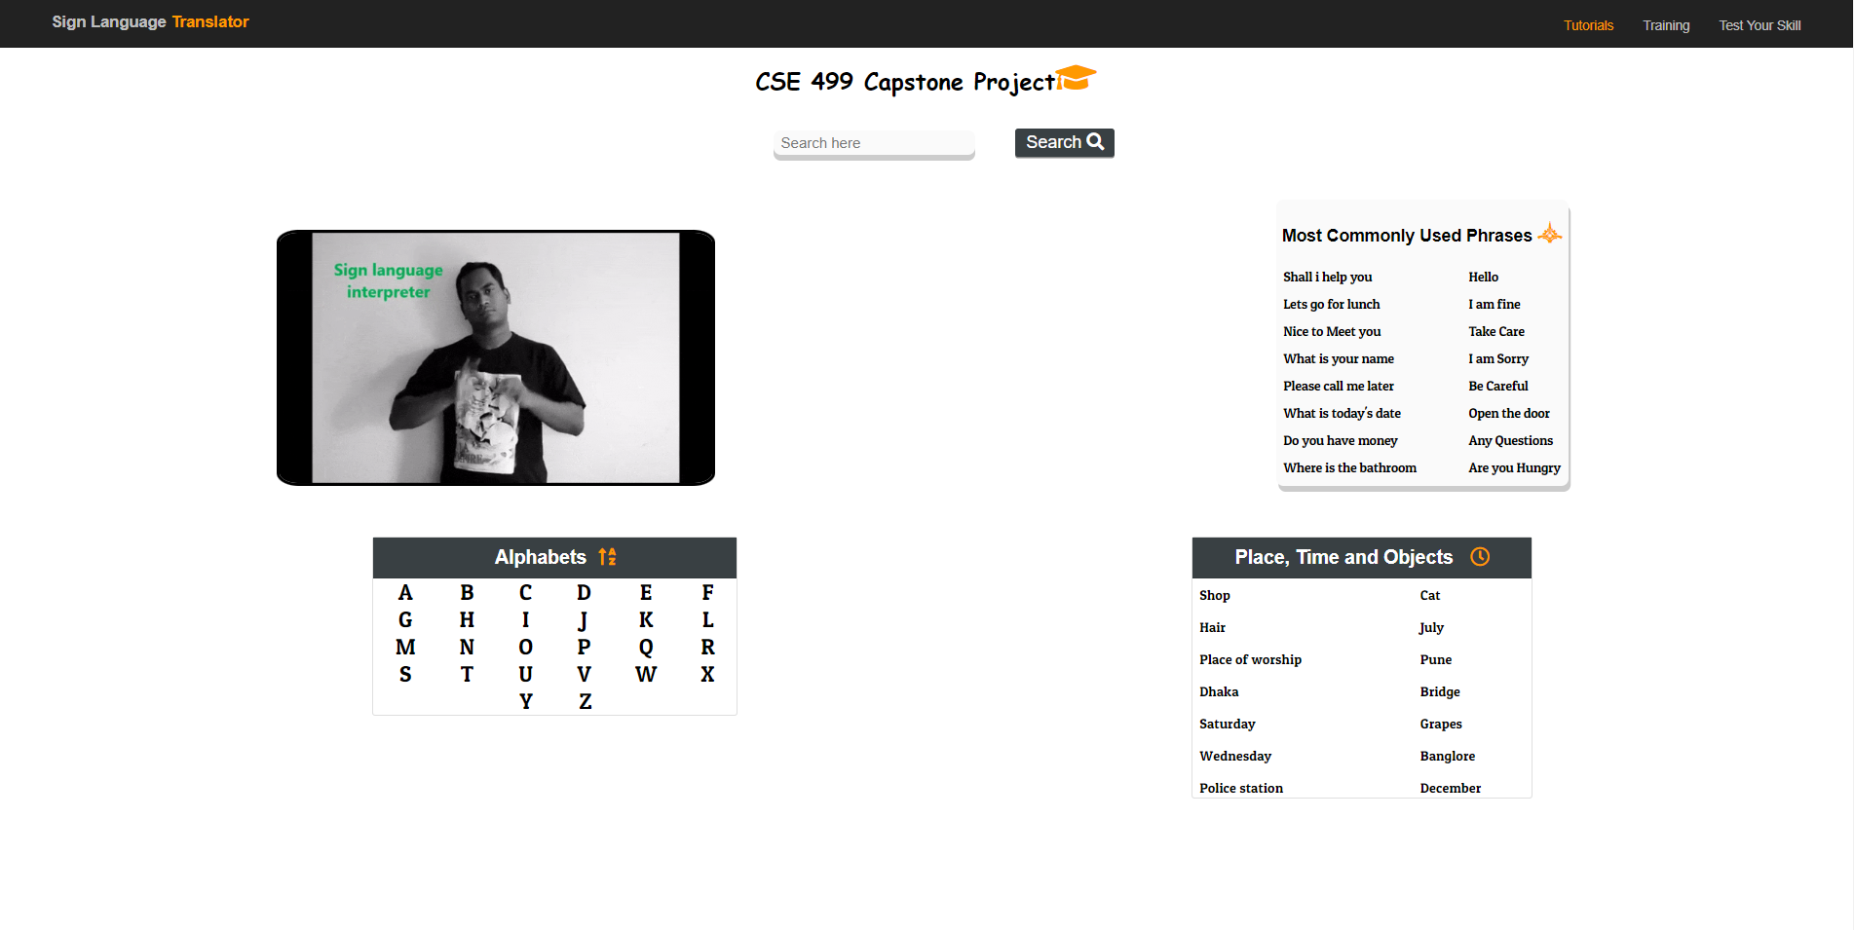
Prototype

Slide 40
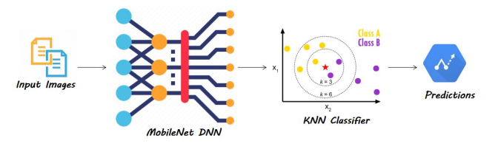
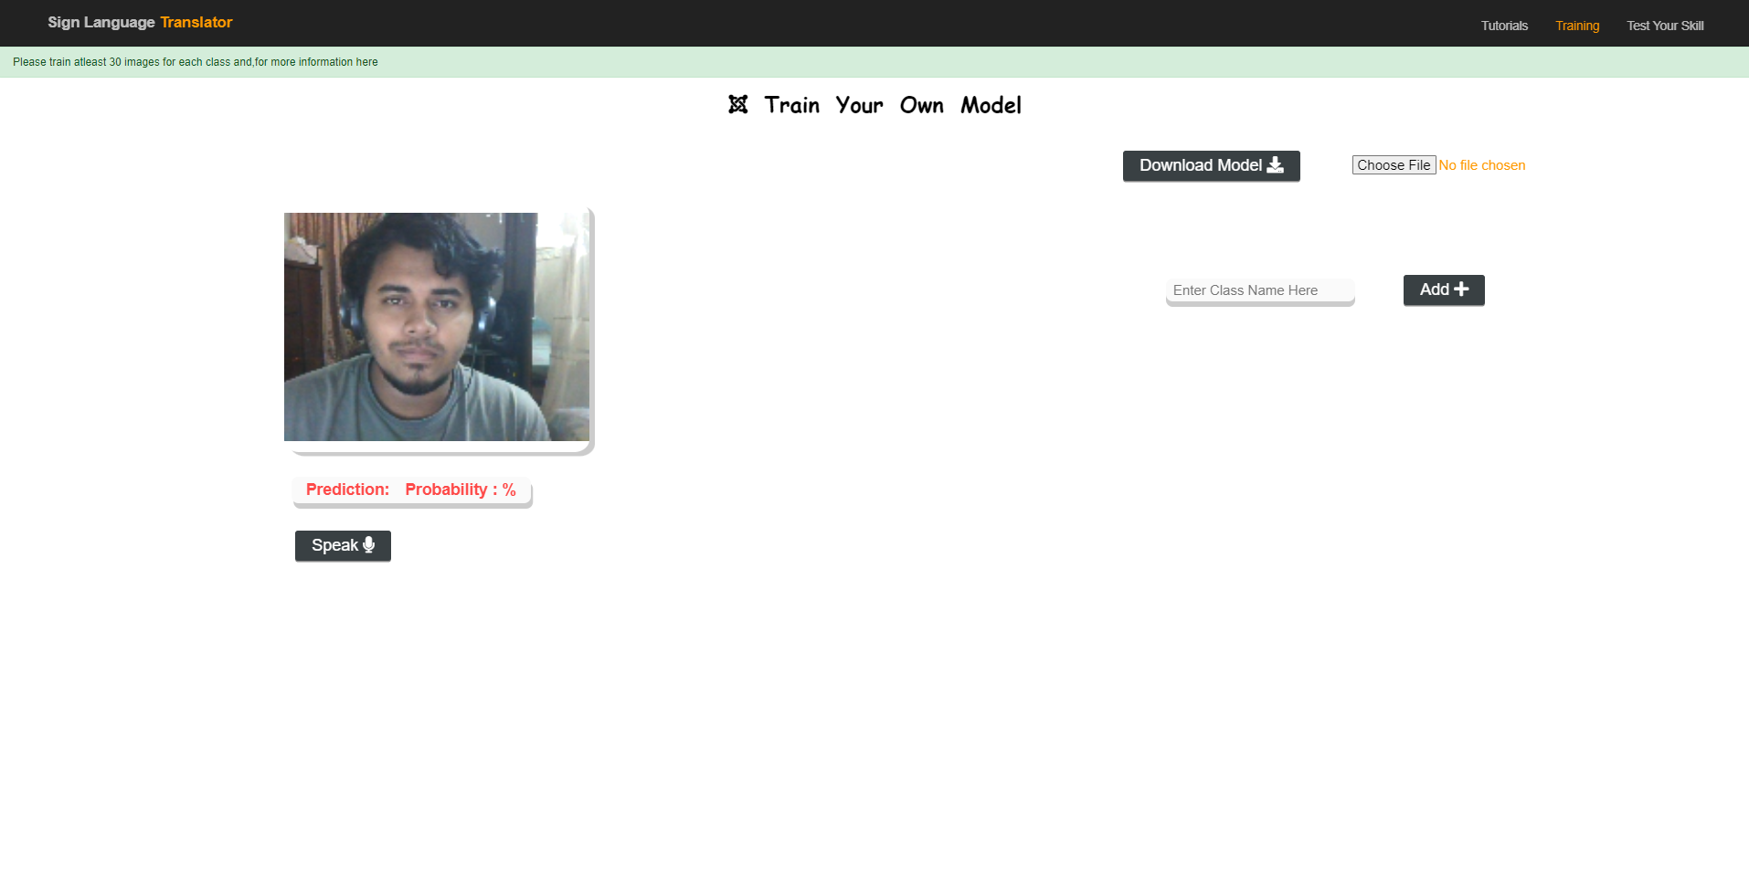

Slide 41
Future Scope

Slide 42
What we are planning to do in future
Training More Model
Working with Video Dataset
Work on sentence level
Combining Multiple Model
Altering Existing Model

Slide 43
Course Outcome-01

Slide 44
Analyze
Research Paper
What are we going to do?
How we will do it?
What do we need to do it?
Who will do what?
What is the timeframe?
Two thing helped us
Existing Solution

Slide 45
Research Paper
99.28% accuracy.
Bangla Sign alphabet recognition with zero-shot and transfer learning
95.21% accuracy.
Real-Time Sign Language Gesture (Word) Recognition from Video Sequences Using CNN and RNN.
99.4% accuracy.
Design of Sign Language Recognition Using E-CNN
Repeat
98% accuracy.
We intend to keep doing this process till we can get a big pool of values through which we can find the best and most efficient to use.
Deepsign: Sign Language Detection and Recognition Using Deep Learning

Slide 46
Existing Solution
American Sign Language (87 thousand image dataset):
Leap Motion Controller
Kinect Sensor
Data Gloves
Vision Based

Slide 47
Inception V3
Convolution
Convolution
Convolution
Output
FULLY CONNECTED
Bb
Pooling
Pooling

Slide 48
Datasets
Bangla Sign Language
Bangla Sign Language
American Sign Language
American Sign Language
BdSL
BSL
ASL-1
ASL-2
34,151 Images
21,338 for training
12,813 for testing
Source: BdSL using Zero Shot Learning (Paper)
12,581 Images
8,068 for training
4.513 for testing
Source: Kaggle (Open Source)
6,500 Images
5,200 for training
1,300 for testing
Source: Kaggle (Open Source)
87,000 Images
69,600 for training
17,400 for testing
Source: Kaggle (Open Source)

Slide 49
Bangla Sign Language (Zero-Shot Learning): (35 thousand images)

Slide 50
Course Outcome-02

Slide 51
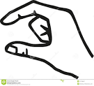
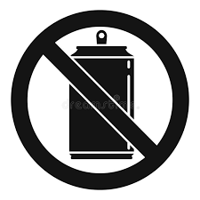



Environmental considerations
Small Size Apps
No energy waste
Not Radiation
Zero Carbon Footprint
No heat consumption

Slide 52
Course Outcome-03

Slide 53
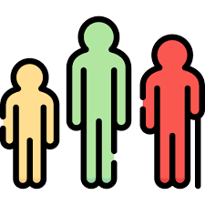
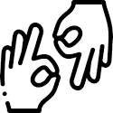

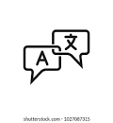
Usability
People of all age
For deaf people
For all device
Language independent

Slide 54
Manufacturing
Sustainability
Software based solution
Safe & Simple
Reusable Code
No extra device
Lower damage probability
No industrial involvement
Releasing new version
Continuous inspection

Slide 55
Course Outcome-04

Slide 56
Using modern analysis and design tools
Pytorch
Designing and Validating
Latex
Tensorflow
Github
Google Colab
Cloud Storage
CNN Architectural Design

Slide 57
